Slide 1
Agenda
Azure Pipelines: CI/CD
Azure Pipelines
What is CI/CD?
Steps to Configure an Azure Pipeline
Azure Pipeline Structure
Pipeline Agents
Creating Pipeline with Web App
Configuring Pipeline with YAML
Database Pipeline with Azure SQL
CI/CD Pipeline with Virtual Machine

Slide 2
Azure Pipeline
A cloud service, used to automatically build and test your project code and making it available to users.
Works with any language or project type.
Combines continuous integration (CI) and continuous delivery (CD) to constantly and consistently test and build your code and ship it to any target.

Slide 3
Continuous Integration (CI)
Developer
Version Control Repository
CI Server
(Build, Test)
Commit
Pull
Notes:
Continuous Integration means Integration of completed code in the common repository which is shared across the team. Each time the developer starts the code check-in, it will automatically get verified by automated tests and automated build. Version control plays a major role here as we can manage all code with branching policy to avoid code conflicts between the team.

Slide 4
Continuous Delivery (CD)
Developer1
Version Control Repository
CI Server
(Build, Test)
Devloper2
Dev/Prod Environment
Commit
Pull
Deploy
Commit
Notes:
Continuous Delivery is one step further of Continuous Integration, as once we have a successful build ready and if it passes the automated acceptance tests as per the business need, we can deploy manually on production.

Slide 5
Continuous Delivery & Continuous Deployment
Source
Build
Staging
Production
Auto
Auto
Manual
Continuous Delivery
Source
Build
Staging
Production
Auto
Auto
Auto
Continuous Deployment
Notes:
Continuous Delivery is one step further of Continuous Integration, as once we have a successful build ready and if it passes the automated acceptance tests as per the business need, we can deploy manually on production.
vContinuous Deployment is a further extension of Continuous Delivery, where the deployment to production is automated without any human interaction. Once the developer makes the code check-in deployment pipelines will automatically start the integration and deployment automatically on the production until and unless there is any failure in the acceptance test script.

Slide 6
Steps to Configure a Azure Pipeline
Connect
Select
Configure
Review
Notes:
Connect: to connect with your code repo from git or GitHub.
Select: select your repository and branch you want to build.
Configure: there are lots of default templates available to achieve the tasks also you can set Configuration as code sing YAML.
Apply the appropriate templates and setup the agent and other configurations.
Review: to run the tasks and review the live progress and logs of all the activities.

Slide 7




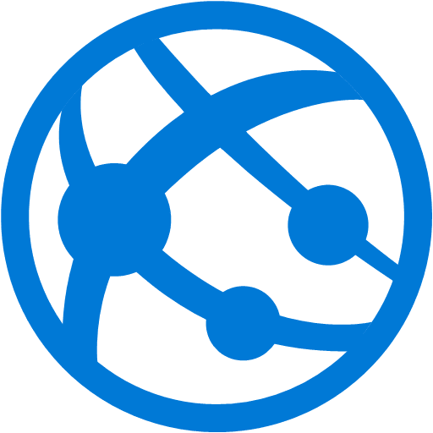
Azure Pipeline with Azure Web Apps
Developer
Visual Studio
Azure Repos
Azure Pipeline
Azure Web App
Notes:
Continuous Delivery is one step further of Continuous Integration, as once we have a successful build ready and if it passes the automated acceptance tests as per the business need, we can deploy manually on production.
vContinuous Deployment is a further extension of Continuous Delivery, where the deployment to production is automated without any human interaction. Once the developer makes the code check-in deployment pipelines will automatically start the integration and deployment automatically on the production until and unless there is any failure in the acceptance test script.

Slide 8
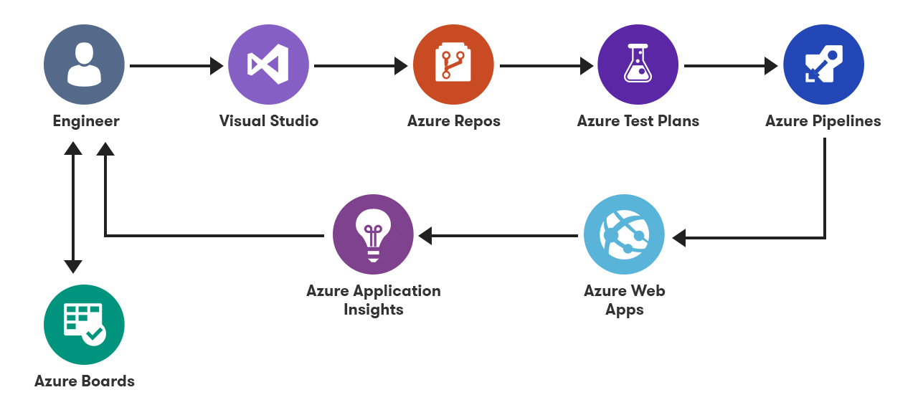
Azure Pipeline with Azure Web Apps
Notes:
Continuous Delivery is one step further of Continuous Integration, as once we have a successful build ready and if it passes the automated acceptance tests as per the business need, we can deploy manually on production.
vContinuous Deployment is a further extension of Continuous Delivery, where the deployment to production is automated without any human interaction. Once the developer makes the code check-in deployment pipelines will automatically start the integration and deployment automatically on the production until and unless there is any failure in the acceptance test script.

Slide 9
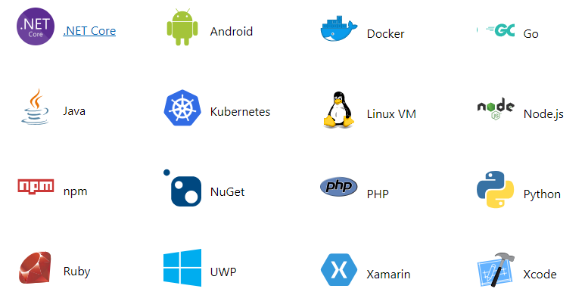
Azure Pipelines Platform Support

Slide 10
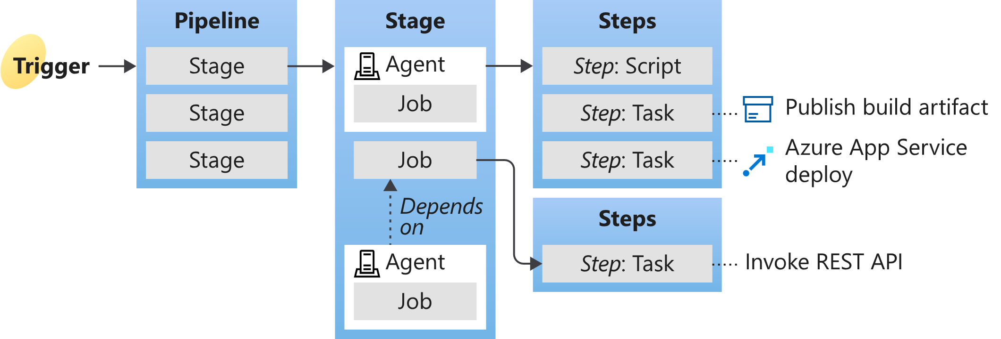
Azure Pipeline Structure
A pipeline has one or more stages to describe a CI/CD process.
Stages are the major divisions in a pipeline.

Slide 11
Azure Pipeline YAML Example
name: my-pipeline-v1
variables:
project: xyz
build_no: 1.0.1
stages:
- stage: Build
jobs:
- job: BuildJob
steps:
- script: 'echo Building $(project)!'
- stage: Deploy
jobs:
- job: Deploy
steps:
- script: 'echo Deploying $(build_no)!'
Notes:
# For Custom Agent
pool: MyPool
name: my-pipeline
variables:
project: xyz
stages:
- stage:
jobs:
- job: buildjob
steps:
- script: 'echo building $($project)!'

Slide 12
YAML
YAML is a human friendly data serialization standard for all programming languages.
Used for defining configuration or in an application where data is being stored or transmitted.
YAML is introduced in 2001.
Extension are .yml or .yaml
YAML is case sensitive.
YAML supports spaces instead of tabs.

Slide 13
XML vs. JSON vs. YAML
<Servers>
<Server>
<name>server1</name>
<location>india</location>
<status>active</status>
</Server>
</Servers>
{
"Servers": [
"Server": {
"name": "server1",
"location": "india",
"status": "active"
}
]
}
Servers:
- name: server1
location: india
status: active

Slide 14
YAML in Action
integer: 25
string1: name
string2: "name"
string3: 'name'
float: 25.0
boolean: true
name: server1
location: india
status: active
Servers:
- server1
- server2
- server3
Key/Value
Array/List: Ordered
Basic: Datatype
Servers:
- server1:
location: india
status: active
- server2:
location: usa
status: active
Servers:
name: server1
status: active
location: india
Dictionary/Map: Unordered
Array/Dictionary/Key-value

Slide 15
Azure Pipeline: Stage
A stage is a collection of related jobs.
By default, stages run sequentially. Each stage starts only after the preceding stage is complete.
Use approval checks to manually control when a stage should run.
stages:
- stage: string # name of the stage (A-Z, a-z, 0-9, and underscore)
displayName: string # friendly name to display in the UI
dependsOn: string | [ string ]
condition: string
variables:
jobs: []

Slide 16
Azure Pipeline: Job
A job is a collection of steps run by an agent or on a server.
A Job can run conditionally and depend on earlier job.
jobs:
- job: string # name of the job
displayName: string # name to display in the UI
dependsOn: string | [ string ]
condition: string
strategy:
parallel: # parallel strategy
continueOnError: boolean # defaults to 'false'
pool: pool
workspace:
clean: outputs | resources | all # clean up before the job runs
variables: # define variable
steps: [] # define variable

Slide 17
Azure Pipeline: Steps
A step is a linear sequence of operations to make a job.
Each step runs in its own process on an agent and has access to the pipeline workspace.
Environment variables aren't preserved between steps but file system changes preserved.
steps: [ script | bash | pwsh | powershell | checkout | task | templateReference ]

Slide 18
Agents
An agent is a software that runs one job at a time.
To build your code or deploy your code using Azure Pipelines, you need at least one agent.
Jobs can be run directly on the host machine of the agent or in a container.
Two Types of agents : Microsoft-hosted agents, Self-hosted agents

Slide 19
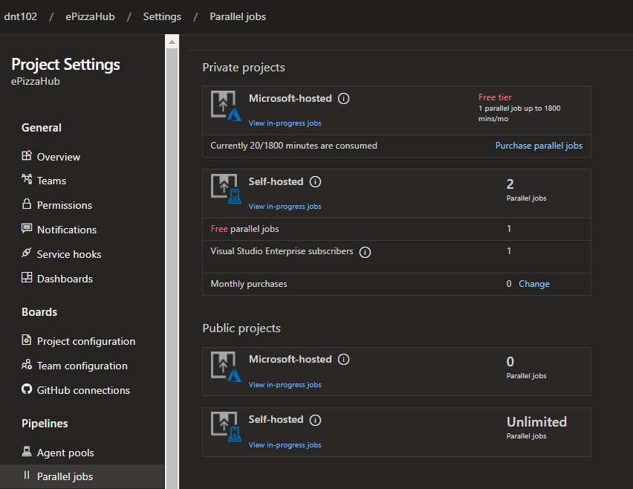
Microsoft-hosted agents
With Microsoft-hosted agents, maintenance and upgrades are taken care of by Microsoft.
Each time you run a pipeline, you get a fresh virtual machine.
The virtual machine is discarded after one use.
Microsoft-hosted agents can run jobs directly on the VM or in a container.

Slide 20
Self-hosted agents
An agent that you set up and manage to run jobs.
Self-hosted agents give you more control to install dependent software needed for your builds and deployments.
A Self-hosted can be installed on Linux, macOS, Windows machines or Docker container.

Slide 21
DEMO
Custom Agent

Slide 22
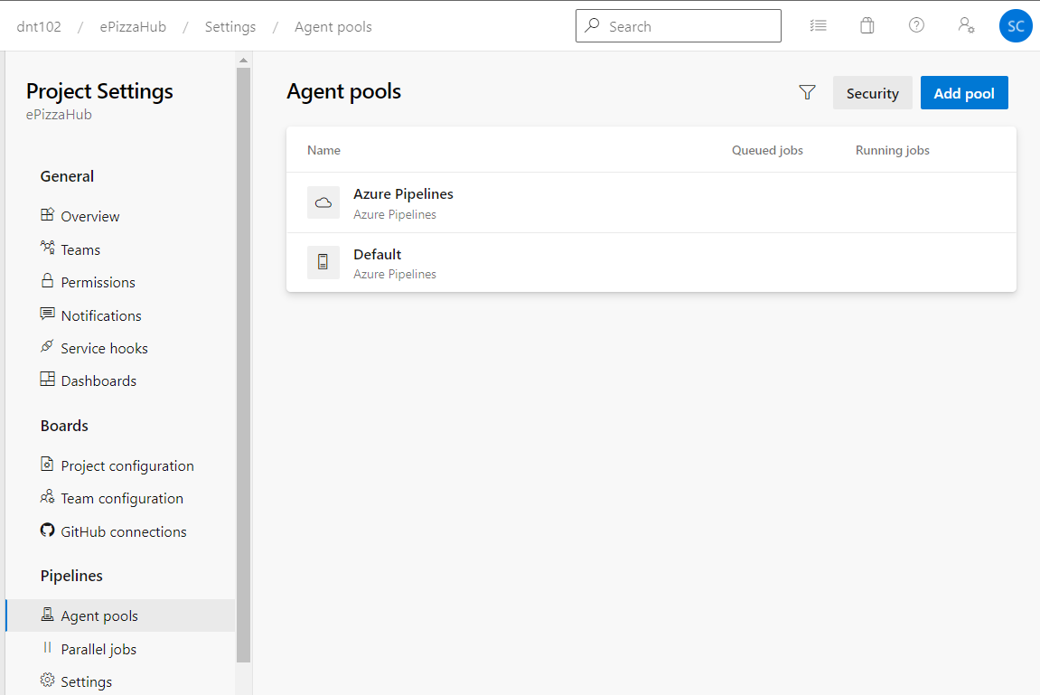
Steps to Configure a Custom Agent
Create Pool
Click New Agent (Download Agent)
Create Personal Token
Configure Downloaded Agent
> C:\CustomAgent>config
> Enter server Url > https://dev.azure.com/dnttestorg
> Enter personal access token > vcrqdthhpmskije7rygnai2grrzet4ock7e4cm
> Enter agent pool > Demo Pool
> Enter agent name > MyDemoVm
> Enter work folder > C:\CustomAgent\workdir
-- If it’s offline
> C:/CustomAgent> run
Notes:
Connect: to connect with your code repo from git or GitHub.
Select: select your repository and branch you want to build.
Configure: there are lots of default templates available to achieve the tasks also you can set Configuration as code sing YAML.
Apply the appropriate templates and setup the agent and other configurations.
Review: to run the tasks and review the live progress and logs of all the activities.
Agents pools - Azure Pipelines | Microsoft Docs
D:\DevOps\Agent>config
___ ______ _ _ _
/ _ \ | ___ (_) | (_)
/ /_\ \_____ _ _ __ ___ | |_/ /_ _ __ ___| |_ _ __ ___ ___
| _ |_ / | | | '__/ _ \ | __/| | '_ \ / _ \ | | '_ \ / _ \/ __|
| | | |/ /| |_| | | | __/ | | | | |_) | __/ | | | | | __/\__ \
\_| |_/___|\__,_|_| \___| \_| |_| .__/ \___|_|_|_| |_|\___||___/
| |
agent v2.190.0 |_| (commit 1735eac)
>> Connect:
Enter server URL > https://dev.azure.com/dnt101
Enter authentication type (press enter for PAT) > thdyodr2ywifypsnw6lesgo4ah4rstjvggt2it73avgufvsgeuhq
Enter a valid value for authentication type.
Enter authentication type (press enter for PAT) >
Enter personal access token > ****************************************************
Connecting to server ...
>> Register Agent:
Enter agent pool (press enter for default) >
Enter agent name (press enter for SHAILENDRA) >
Scanning for tool capabilities.
Connecting to the server.
Successfully added the agent
Testing agent connection.
Enter work folder (press enter for _work) > D:\DevOps\Agent\WorkDir
2021-08-14 15:29:54Z: Settings Saved.
Enter run agent as service? (Y/N) (press enter for N) > Y
Error reported in diagnostic logs. Please examine the log for more details.
- D:\DevOps\Agent\_diag\Agent_20210814-152724-utc.log
Needs Administrator privileges for configuring agent as windows service.
D:\DevOps\Agent>run

Slide 23
Setting Custom Agent in Pipeline
# ASP.NET Core Build Pipeline
trigger:
- master
pool:
name: DefaultPool # Name of the custom agent pool
vmImage: 'custom-agent' # Name of the custom agent
variables:
projectPath: '$(Build.SourcesDirectory)/ePizzaHub.UI/*.csproj'
testProjectPath: '$(Build.SourcesDirectory)/ePizzaHub.UI.Test/*.csproj'
buildPlatform: 'Any CPU'
buildConfiguration: 'Release'

Slide 24
Azure Pipeline Built-In Variables
Agent variables - Agent.BuildDirectory, Agent.JobStatus, Agent.Name etc.
Build variables - Build.ArtifactStagingDirectory, Build.BuildNumber etc.
Pipeline variables - Pipeline.Workspace
Deployment job variables - Environment.Name, Environment.Id etc.
System variables - System.JobName, System.StageName etc.
Reference: https://docs.microsoft.com/en-us/azure/devops/pipelines/build/variables
Notes:
https://docs.microsoft.com/en-us/azure/devops/pipelines/build/variables?view=azure-devops&tabs=yaml

Slide 25
Variable Scopes
At the root level, to make it available to all jobs in the pipeline.
At the stage level, to make it available only to a specific stage.
At the job level, to make it available only to a specific job.
variables:
# a regular variable
- name: myvariable
value: myvalue
# a variable group
- group: myvariablegroup
# a reference to a variable template
- template: myvariabletemplate.yml
Notes:
https://docs.microsoft.com/en-us/azure/devops/pipelines/build/variables?view=azure-devops&tabs=yaml

Slide 26
Different Types of Builds
CI Build
Continuous Integration
Compile/Test
Nightly Build
Schedule
Compile/Integration Testing/Code Analysis
Release Build
Manual
Compile/Test/ Regression/Archive
Notes:
Continuous Delivery is one step further of Continuous Integration, as once we have a successful build ready and if it passes the automated acceptance tests as per the business need, we can deploy manually on production.
vContinuous Deployment is a further extension of Continuous Delivery, where the deployment to production is automated without any human interaction. Once the developer makes the code check-in deployment pipelines will automatically start the integration and deployment automatically on the production until and unless there is any failure in the acceptance test script.

Slide 27
DEMO
Build Pipelines For .NET Core

Slide 28
# ASP.NET Core Build Pipeline
trigger:
- master
pool:
vmImage: 'ubuntu-latest'
#vmImage: 'windows-latest'
variables:
buildConfiguration: 'Release'
steps:
- script: dotnet build --configuration $(buildConfiguration)
displayName: 'dotnet build $(buildConfiguration)'
- task: DotNetCoreCLI@2
inputs:
command: 'publish'
publishWebProjects: true
arguments: '--configuration $(buildConfiguration) --output $(Build.ArtifactStagingDirectory)’
zipAfterPublish: true
- task: PublishBuildArtifacts@1
inputs:
PathtoPublish: '$(Build.ArtifactStagingDirectory)'
ArtifactName: 'drop'
publishLocation: 'Container'
Notes:
# For Custom Agent
pool: MyPool
---------------------------------------------------------------
trigger:
- master
# The branch you are building.
pool:
vmImage: 'Ubuntu-16.04'
# The type of VM your code will run on.
variables:
buildConfiguration: 'Release'
#This ends up defining which webconfig file to use.
steps:
- script: dotnet restore
displayName: Restoring Dependencies
- script: dotnet build --configuration $(buildConfiguration)
displayName: 'dotnet build $(buildConfiguration)'
# Builds your application
- task: DotNetCoreCLI@2
displayName: Unit Tests
inputs:
command: test
projects: '**/*Tests/*.csproj'
arguments: '--configuration $(buildConfiguration)'
#Runs unit tests for your application
- task: DotNetCoreCLI@2
displayName: Publishing
inputs:
command: publish
publishWebProjects: True
arguments: '--configuration $(BuildConfiguration) --output $(Build.ArtifactStagingDirectory)'
zipAfterPublish: True
#Pushes your application as an artifact (You'll be able to see it in your list of artifacts in Azure DevOps)
- task: PublishBuildArtifacts@1

Slide 29
# ASP.NET Core with Tests Build Pipeline
trigger:
- master
pool:
vmImage: 'ubuntu-latest'
variables:
buildConfiguration: 'Release'
steps:
- script: dotnet build --configuration $(buildConfiguration)
displayName: 'dotnet build $(buildConfiguration)’
- task: DotNetCoreCLI@2
displayName: Test
inputs:
command: 'test'
projects: '**/*[Tt]ests/*.csproj'
- task: DotNetCoreCLI@2
displayName: Publish
inputs:
command: 'publish'
publishWebProjects: true
arguments: '--configuration $(buildConfiguration) --output $(Build.ArtifactStagingDirectory)’
- task: PublishBuildArtifacts@1
inputs:
PathtoPublish: '$(Build.ArtifactStagingDirectory)'
ArtifactName: 'drop'
publishLocation: 'Container'
Notes:
trigger:
- master
# The branch you are building.
pool:
vmImage: 'Ubuntu-16.04'
# The type of VM your code will run on.
variables:
buildConfiguration: 'Release'
#This ends up defining which webconfig file to use.
steps:
- script: dotnet restore
displayName: Restoring Dependencies
- script: dotnet build --configuration $(buildConfiguration)
displayName: 'dotnet build $(buildConfiguration)'
# Builds your application
- task: DotNetCoreCLI@2
displayName: Unit Tests
inputs:
command: test
projects: '**/*Tests/*.csproj'
arguments: '--configuration $(buildConfiguration)'
#Runs unit tests for your application
- task: DotNetCoreCLI@2
displayName: Publishing
inputs:
command: publish
publishWebProjects: True
arguments: '--configuration $(BuildConfiguration) --output $(Build.ArtifactStagingDirectory)'
zipAfterPublish: True
#Pushes your application as an artifact (You'll be able to see it in your list of artifacts in Azure DevOps)
- task: PublishBuildArtifacts@1

Slide 30
DEMO
Azure SQL Database YAML Pipeline

Slide 31
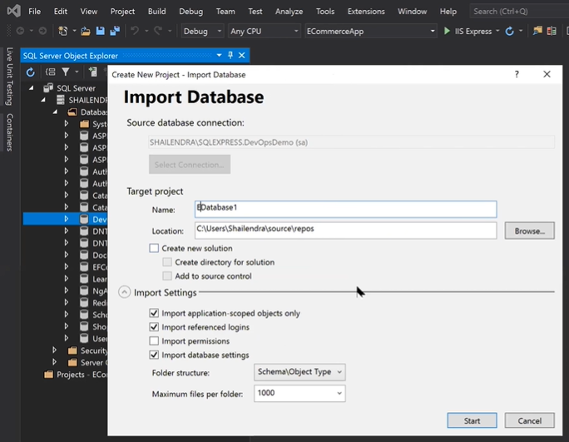
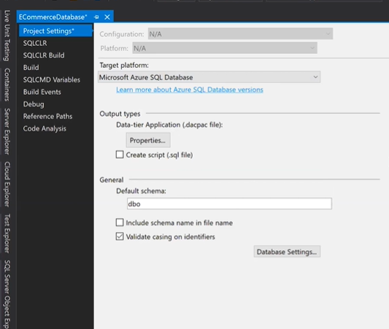
Creating Database Project
Notes:
DACPAC - which includes only the structure
BACPAC which includes data and structure.

Slide 32
# SQL Server Database YAML Pipeline
trigger:
- master
pool:
vmImage: 'windows-latest'
variables:
sqlProjectPath: '$(Build.SourcesDirectory)/ePizzaHub.SQLDb/*.sqlproj'
steps:
- task: MSBuild@1
displayName: 'Build Sql Project'
inputs:
solution: '$(sqlProjectPath)’
- task: CopyFiles@2
displayName: 'Copy Dacpac File to Artifact'
inputs:
SourceFolder: '$(agent.builddirectory)'
Contents: '**/*.dacpac'
TargetFolder: '$(build.artifactstagingdirectory)’
- task: PublishBuildArtifacts@1
displayName: 'Publsihing to Artifact'
inputs:
PathtoPublish: '$(Build.ArtifactStagingDirectory)'
ArtifactName: 'drop'
publishLocation: 'Container’

Slide 33
DEMO
Classical Release Pipeline

Slide 34
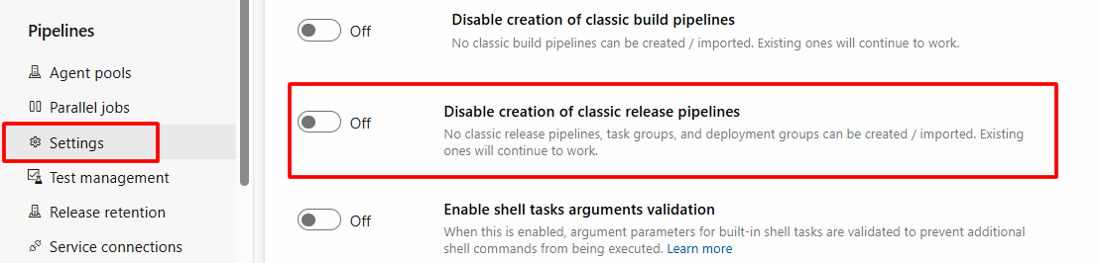
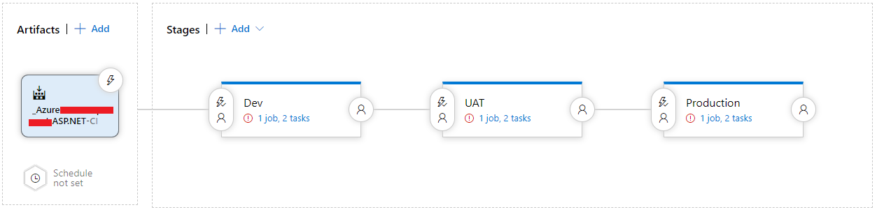
Classical Release pipeline
Enable on Project Settings Level
Notes:
Making Azure Connection: Connecting Azure DevOps with Azure | by Clyde D'Souza | Medium

Slide 35
Demo
Build and Release Pipelines For .NET Core

Slide 36
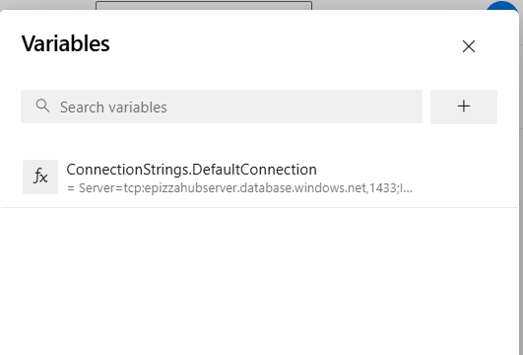
# ASP.NET Core Build & Release Pipeline: For changing Connection String in appsettings.json create variable at pipeline level as shown in pic
trigger:
- master
pool:
vmImage: 'windows-latest'
variables:
projectPath: '$(Build.SourcesDirectory)/ePizzaHub.UI/*.csproj'
buildConfiguration: 'Release'
steps:
- task: DotNetCoreCLI@2
displayName: 'Build Code'
inputs:
command: 'build'
projects: '$(projectPath)'
arguments: '--configuration $(buildConfiguration)'
- task: DotNetCoreCLI@2
displayName: 'Publish Code'
inputs:
command: 'publish'
publishWebProjects: true
arguments: '--configuration $(buildConfiguration) --output $(Build.ArtifactStagingDirectory)'
- task: FileTransform@2
inputs:
folderPath: '$(Build.ArtifactStagingDirectory)/**.zip’
enableXmlTransform: false
enableJsonTransform: true
jsonTargetFiles: '**/appsettings.json'
- task: PublishBuildArtifacts@1
displayName: 'Publishing to Artifact'
inputs:
PathtoPublish: '$(Build.ArtifactStagingDirectory)'
ArtifactName: 'drop'
publishLocation: 'Container'
- task: AzureRmWebAppDeployment@4
inputs:
ConnectionType: 'AzureRM'
azureSubscription: 'Azure Subscription (4cc400bc-8706-4682-b513-3a847ab32c7f)'
appType: 'webApp'
WebAppName: 'ePizzaHubApp'
deployToSlotOrASE: true
ResourceGroupName: 'ScholarRg'
SlotName: 'staging'
packageForLinux: '$(Build.ArtifactStagingDirectory)/**/*.zip'
Notes:
# For Custom Agent
pool: MyPool
---------------------------------------------------------------
trigger:
- master
# The branch you are building.
pool:
vmImage: 'Ubuntu-16.04'
# The type of VM your code will run on.
variables:
buildConfiguration: 'Release'
#This ends up defining which webconfig file to use.
steps:
- script: dotnet restore
displayName: Restoring Dependencies
- script: dotnet build --configuration $(buildConfiguration)
displayName: 'dotnet build $(buildConfiguration)'
# Builds your application
- task: DotNetCoreCLI@2
displayName: Unit Tests
inputs:
command: test
projects: '**/*Tests/*.csproj'
arguments: '--configuration $(buildConfiguration)'
#Runs unit tests for your application
- task: DotNetCoreCLI@2
displayName: Publishing
inputs:
command: publish
publishWebProjects: True
arguments: '--configuration $(BuildConfiguration) --output $(Build.ArtifactStagingDirectory)'
zipAfterPublish: True
#Pushes your application as an artifact (You'll be able to see it in your list of artifacts in Azure DevOps)
- task: PublishBuildArtifacts@1

Slide 37
Demo
Build and Release Pipelines For Angular/React

Slide 38
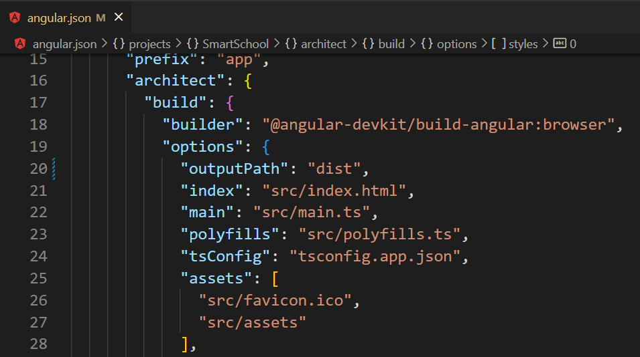
# Angular14 Deployment on Windows VM for Build and Release Combined Pipeline
trigger:
- master
pool:
vmImage: ubuntu-latest
steps:
- task: NodeTool@0
inputs:
versionSource: 'spec'
versionSpec: '16.x'
checkLatest: true
displayName: 'Install Node.js'
- script: |
npm install -g @angular/cli@14
npm install
ng build --output-path=dist
displayName: 'npm install and build'
- task: ArchiveFiles@2
inputs:
rootFolderOrFile: 'dist'
includeRootFolder: false
archiveType: 'zip'
archiveFile: '$(Build.ArtifactStagingDirectory)/$(Build.BuildId).zip'
replaceExistingArchive: true
- task: PublishBuildArtifacts@1
inputs:
PathtoPublish: '$(Build.ArtifactStagingDirectory)'
ArtifactName: 'drop'
publishLocation: 'Container'
- task: AzureRmWebAppDeployment@4
inputs:
ConnectionType: 'AzureRM'
azureSubscription: 'Azure Subscription(4cc400bc-8706-4682-b513-3a847ab32c7f)'
appType: 'webApp'
WebAppName: 'scholarapp'
packageForLinux: '$(Build.ArtifactStagingDirectory)/**/*.zip'
Notes:
steps:
- task: ArchiveFiles@2
displayName: 'Archive dist'
inputs:
rootFolderOrFile: dist
includeRootFolder: false
Make sure path is dist only not myapp
https://stackoverflow.com/questions/57089308/angular-project-ci-in-azure-devops-giving-error-publishing-build-artifacts-fail
https://www.c-sharpcorner.com/article/create-build-pipeline-for-angular-app-and-download-artifacts-using-azu/

Slide 39
# Node.js with Angular19 on Windows WebApp for Build and Release Combined Pipeline
trigger:
- master
pool:
vmImage: ubuntu-latest
steps:
- task: NodeTool@0
inputs:
versionSpec: '20.x'
displayName: 'Install Node.js'
- script: |
npm install -g @angular/cli
npm install
ng build --configuration=production --output-path=dist
displayName: 'npm install and build'
- task: ArchiveFiles@2
inputs:
rootFolderOrFile: 'dist/browser'
includeRootFolder: false
archiveType: 'zip'
archiveFile: '$(Build.ArtifactStagingDirectory)/$(Build.BuildId).zip'
replaceExistingArchive: true
- task: PublishBuildArtifacts@1
inputs:
PathtoPublish: '$(Build.ArtifactStagingDirectory)'
ArtifactName: 'drop'
publishLocation: 'Container'
- task: AzureWebApp@1
inputs:
azureSubscription: 'Azure Subscription(4cc400bc-8706-4682-b513-3a847ab32c7f)'
appType: 'webApp'
appName: 'angularappwin'
package: '$(Build.ArtifactStagingDirectory)/**/*.zip'
deploymentMethod: 'auto'
Notes:
steps:
- task: ArchiveFiles@2
displayName: 'Archive dist'
inputs:
rootFolderOrFile: dist
includeRootFolder: false
Make sure path is dist only not myapp
https://stackoverflow.com/questions/57089308/angular-project-ci-in-azure-devops-giving-error-publishing-build-artifacts-fail
https://www.c-sharpcorner.com/article/create-build-pipeline-for-angular-app-and-download-artifacts-using-azu/

Slide 40
# Node.js with React for Build and Release Combined Pipeline
trigger:
- master
pool:
vmImage: ubuntu-latest
steps:
- task: NodeTool@0
inputs:
versionSpec: '16.x'
displayName: 'Install Node.js'
- script: |
npm install
npm run build
displayName: 'npm install and build’
- task: ArchiveFiles@2
inputs:
rootFolderOrFile: 'build'
includeRootFolder: false
archiveType: 'zip'
archiveFile: '$(Build.ArtifactStagingDirectory)/$(Build.BuildId).zip’
replaceExistingArchive: true
- task: PublishBuildArtifacts@1
inputs:
PathtoPublish: '$(Build.ArtifactStagingDirectory)'
ArtifactName: 'drop'
publishLocation: 'Container’
- task: AzureRmWebAppDeployment@4
inputs:
ConnectionType: 'AzureRM'
azureSubscription: 'Azure Subscription(4cc400bc-8706-4682-b513-3a847ab32c7f)'
appType: 'webApp'
WebAppName: 'scholarapp'
packageForLinux: '$(Build.ArtifactStagingDirectory)/**/*.zip'
Notes:
- task: CopyFiles@2
inputs:
Contents: 'build/**' # Pull the build directory (React)
TargetFolder: '$(Build.ArtifactStagingDirectory)'
- task: PublishBuildArtifacts@1
inputs:
PathtoPublish: $(Build.ArtifactStagingDirectory) # dist or build files
ArtifactName: 'drop' # output artifact named www

Slide 41
Demo
Build Pipelines For Node.js

Slide 42
# Angular/React with Node.js server setup
var path = require('path');
var express = require('express');
var app = express();
var staticPath = path.join(__dirname, '/client/dist'); // dist or build
app.use(express.static(staticPath));
// All other GET requests not handled before will return our app
app.get('*', (req, res) => {
res.sendFile(path.resolve(staticPath, 'index.html'));
});
// Allows you to set port in the project properties.
var port = process.env.PORT || 3000;
app.set('port', port);
var server = app.listen(app.get('port'), function () {
console.log(`listening: http://localhost:${port}`);
});
{
"name": "smartschool",
"version": "1.0.0",
"description": "",
"main": "server.js",
"scripts": {
"start": "node server.js",
"build": "cd client && npm install && npm run build"
},
"author": "",
"license": "ISC",
"dependencies": {
"express": "^4.17.3",
"path": "^0.12.7"
}
}
Notes:
npm init
npm i express path --save

Slide 43
Demo
Build Pipeline with Stages

Slide 44
# ASP.NET Core Stages
trigger:
- main
pool:
vmImage: 'ubuntu-latest'
variables:
buildConfiguration: 'Release'
stages:
- stage: Dev
jobs:
- job:
steps:
- script: dotnet build --configuration $(buildConfiguration)
displayName: 'dotnet build $(buildConfiguration)'
- task: DotNetCoreCLI@2
inputs:
command: 'publish'
publishWebProjects: true
arguments: '--configuration $(BuildConfiguration) --output $(build.artifactstagingdirectory)'
- task: PublishBuildArtifacts@1
inputs:
PathtoPublish: '$(Build.ArtifactStagingDirectory)'
ArtifactName: 'drop'
publishLocation: 'Container’
Notes:
trigger:
- master
# The branch you are building.
pool:
vmImage: 'Ubuntu-16.04'
# The type of VM your code will run on.
variables:
buildConfiguration: 'Release'
#This ends up defining which webconfig file to use.
steps:
- script: dotnet restore
displayName: Restoring Dependencies
- script: dotnet build --configuration $(buildConfiguration)
displayName: 'dotnet build $(buildConfiguration)'
# Builds your application
- task: DotNetCoreCLI@2
displayName: Unit Tests
inputs:
command: test
projects: '**/*Tests/*.csproj'
arguments: '--configuration $(buildConfiguration)'
#Runs unit tests for your application
- task: DotNetCoreCLI@2
displayName: Publishing
inputs:
command: publish
publishWebProjects: True
arguments: '--configuration $(BuildConfiguration) --output $(Build.ArtifactStagingDirectory)'
zipAfterPublish: True
#Pushes your application as an artifact (You'll be able to see it in your list of artifacts in Azure DevOps)
- task: PublishBuildArtifacts@1

Slide 45
Demo
ARM Templates Based CI/CD

Slide 46
//azuredeploy.json: part-1
{
"$schema": "https://schema.management.azure.com/schemas/2019-04-01/deploymentTemplate.json#",
"contentVersion": "1.0.0.0",
"parameters": {
"webAppName": {
"type": "string",
"metadata": {
"description": "Name of the Web App"
}
},
"appServicePlanName": {
"type": "string",
"metadata": {
"description": "Name of the App Service Plan"
}
},
"skuName": {
"type": "string",
"defaultValue": "S1",
"metadata": {
"description": "SKU Name"
}
},
"skuTier": {
"type": "string",
"defaultValue": "Standard",
"metadata": {
"description": "SKU Tier"
}
},
"skuCapacity": {
"type": "int",
"defaultValue": 1,
"metadata": {
"description": "SKU Capacity"
}
}
},
//azuredeploy.json: part-2
"resources": [
{
"type": "Microsoft.Web/serverfarms",
"apiVersion": "2021-02-01",
"name": "[parameters('appServicePlanName')]",
"location": "[resourceGroup().location]",
"sku": {
"name": "[parameters('skuName')]",
"tier": "[parameters('skuTier')]",
"capacity": "[parameters('skuCapacity')]"
},
"properties": {
"reserved": false,
"perSiteScaling": false,
"maximumElasticWorkerCount": 1,
"elasticScaleEnabled": false
}
},
{
"type": "Microsoft.Web/sites",
"apiVersion": "2021-02-01",
"name": "[parameters('webAppName')]",
"location": "[resourceGroup().location]",
"kind": "app",
"dependsOn": [
"[resourceId('Microsoft.Web/serverfarms', parameters('appServicePlanName'))]"
],
"properties": {
"serverFarmId": "[resourceId('Microsoft.Web/serverfarms', parameters('appServicePlanName'))]"
}
}
]
}
Notes:
trigger:
- master
# The branch you are building.
pool:
vmImage: 'Ubuntu-16.04'
# The type of VM your code will run on.
variables:
buildConfiguration: 'Release'
#This ends up defining which webconfig file to use.
steps:
- script: dotnet restore
displayName: Restoring Dependencies
- script: dotnet build --configuration $(buildConfiguration)
displayName: 'dotnet build $(buildConfiguration)'
# Builds your application
- task: DotNetCoreCLI@2
displayName: Unit Tests
inputs:
command: test
projects: '**/*Tests/*.csproj'
arguments: '--configuration $(buildConfiguration)'
#Runs unit tests for your application
- task: DotNetCoreCLI@2
displayName: Publishing
inputs:
command: publish
publishWebProjects: True
arguments: '--configuration $(BuildConfiguration) --output $(Build.ArtifactStagingDirectory)'
zipAfterPublish: True
#Pushes your application as an artifact (You'll be able to see it in your list of artifacts in Azure DevOps)
- task: PublishBuildArtifacts@1

Slide 47
//azuredeploy.parameters.json
{
"$schema": "https://schema.management.azure.com/schemas/2019-04-01/deploymentParameters.json#",
"contentVersion": "1.0.0.0",
"parameters": {
"webAppName": {
"value": "epizzahub"
},
"appServicePlanName": {
"value": "epizzahub-service-plan"
},
"skuName": {
"value": "S1"
},
"skuTier": {
"value": "Standard"
},
"skuCapacity": {
"value": 1
}
}
}
Notes:
trigger:
- master
# The branch you are building.
pool:
vmImage: 'Ubuntu-16.04'
# The type of VM your code will run on.
variables:
buildConfiguration: 'Release'
#This ends up defining which webconfig file to use.
steps:
- script: dotnet restore
displayName: Restoring Dependencies
- script: dotnet build --configuration $(buildConfiguration)
displayName: 'dotnet build $(buildConfiguration)'
# Builds your application
- task: DotNetCoreCLI@2
displayName: Unit Tests
inputs:
command: test
projects: '**/*Tests/*.csproj'
arguments: '--configuration $(buildConfiguration)'
#Runs unit tests for your application
- task: DotNetCoreCLI@2
displayName: Publishing
inputs:
command: publish
publishWebProjects: True
arguments: '--configuration $(BuildConfiguration) --output $(Build.ArtifactStagingDirectory)'
zipAfterPublish: True
#Pushes your application as an artifact (You'll be able to see it in your list of artifacts in Azure DevOps)
- task: PublishBuildArtifacts@1

Slide 48
Demo
SQL Server Database Classical Build & Release Pipeline

Slide 49
Creating SQL Database Project
Notes:
DACPAC - which includes only the structure
BACPAC which includes data and structure.

Slide 50
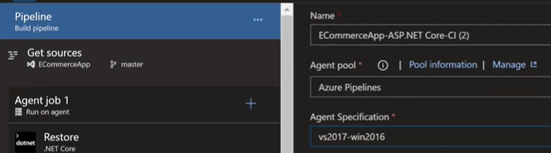
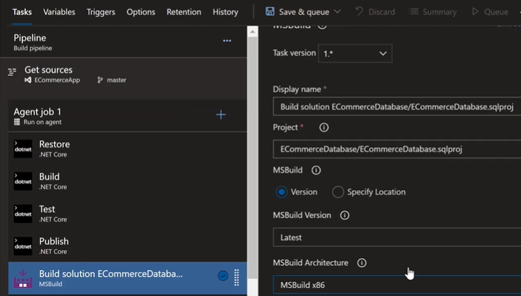
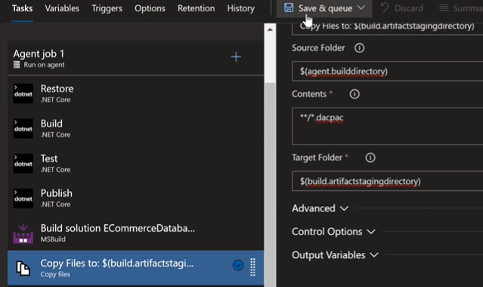
SQL Database Build Pipeline
Notes:
Dacpac= Data Tier Application Package
MS Build can’t run on Ubuntu. It’s need a windows machine with VS

Slide 51
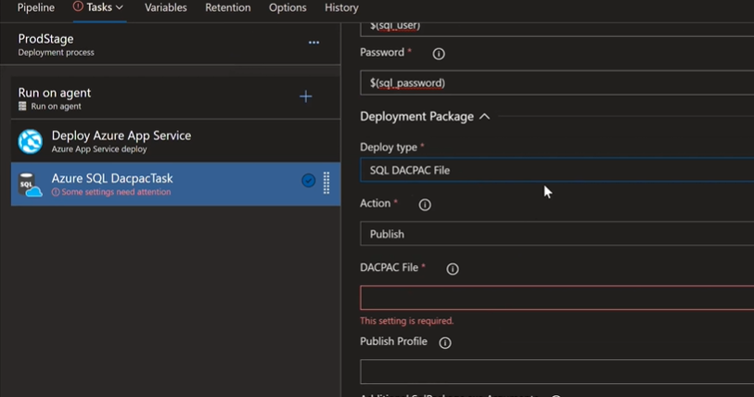
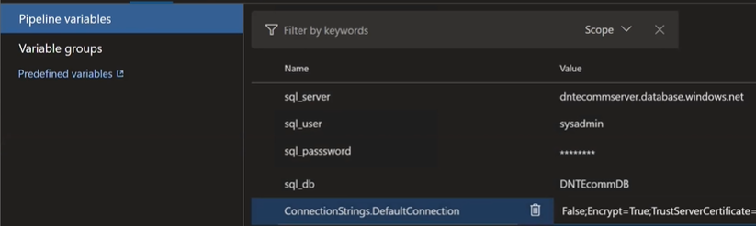
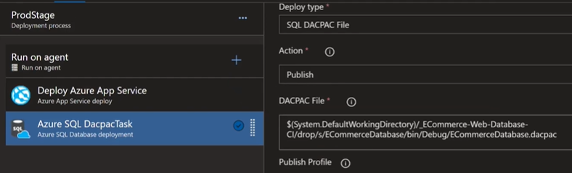
SQL Database Release Pipeline
Notes:
$(sql_server)
$(sql_password)

Slide 52
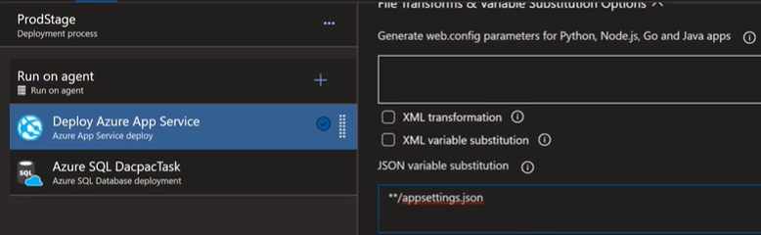
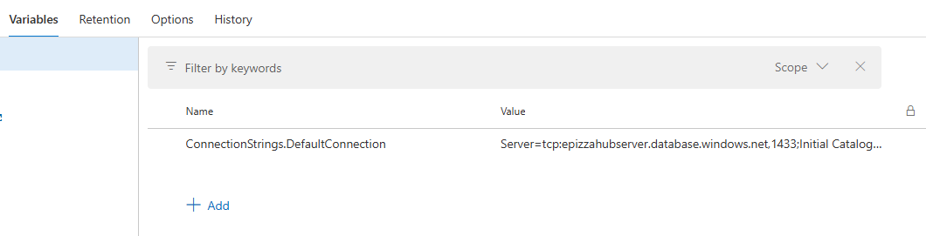
Release Pipeline: Replacing DB Connection

Slide 53
Demo
CI/CD with Virtual Machine

Slide 54
Configuring VM For IIS Deployment
1. Install IIS (with Management Console)
Install-WindowsFeature -name Web-Server –IncludeManagementTools
2. Install ASP.NET 4.6
Install-WindowsFeature Web-Asp-Net45
3. Install .NET Core Hosting Bundle
Download .NET Core Hosting bundle and install it
Notes:
dotnet-install scripts - .NET CLI | Microsoft Docs
dotnet-install.ps1 -Channel 6.0 -Runtime aspnetcore
dotnet-install.ps1 -Channel Current
<AllowUntrustedCertificate>True</AllowUntrustedCertificate>
webdeploy - Can not publish since moving to VS 2019 - Stack Overflow
Steps to Allow a port access in web server:
Add inbound rules for that port using portal
Addcinbound rules for that port in firewall of VM
3. Configure DNS and Inbound Rule for Port 8172
Set DNS name with static IP at VM level
Add Inbound Rule for port 8172 using PortType TCP at NSG for VM

Slide 55
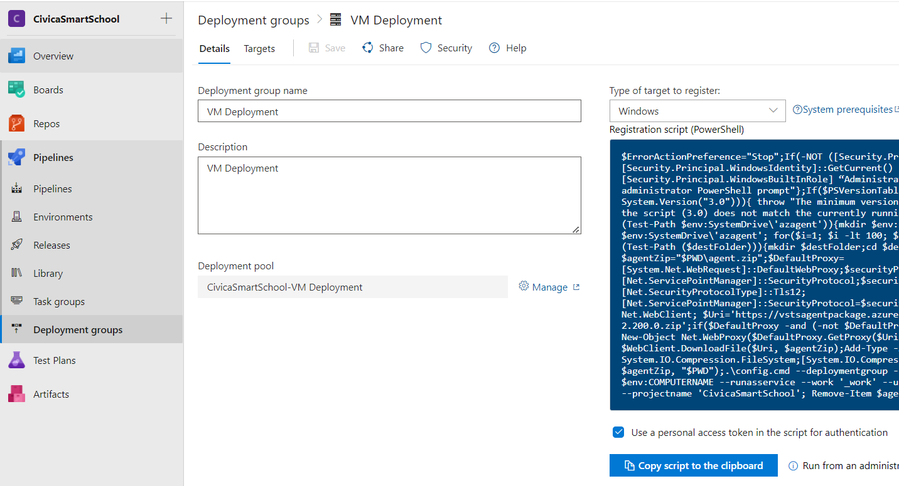
Create Deployment Group

Slide 56
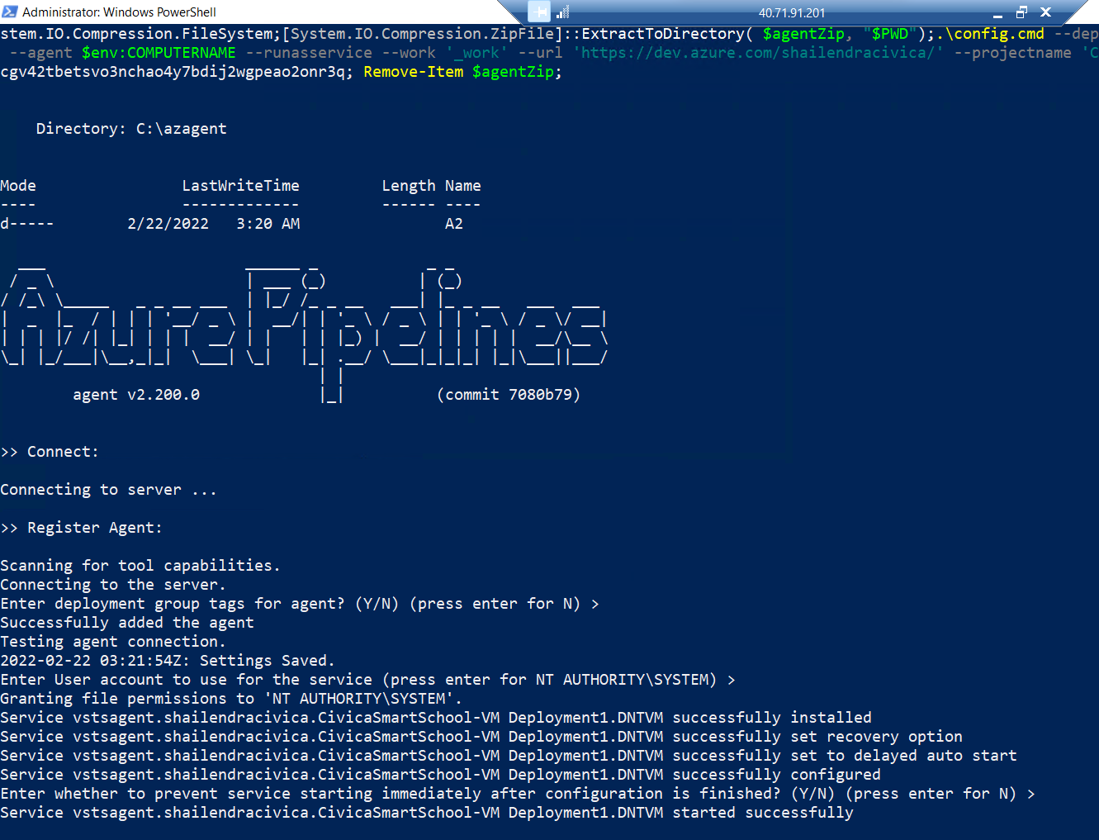
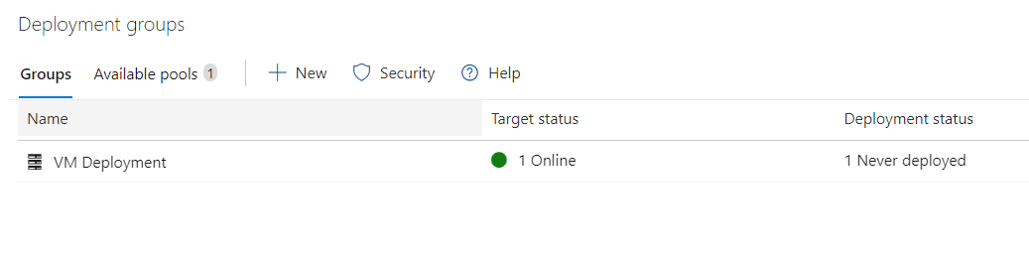
Setting Up VM For CI/CD

Slide 57
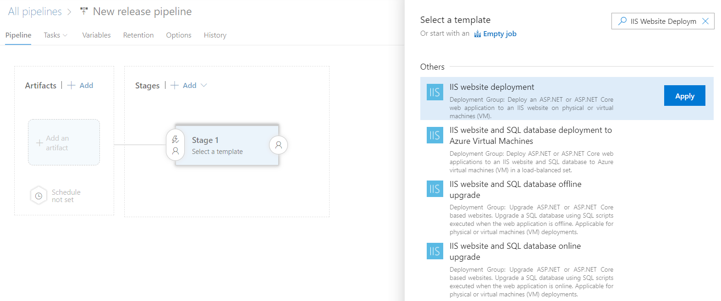
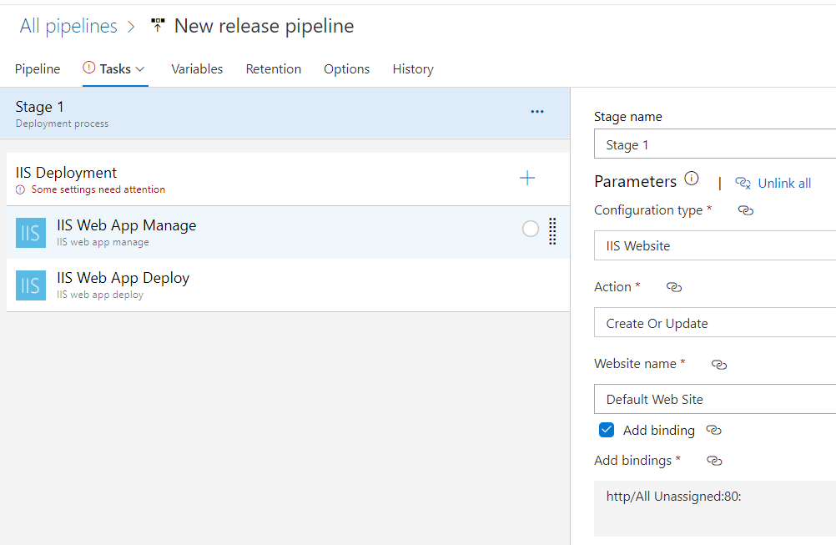
Creating Release Pipeline - Part1
Notes:
Continuous Deployment🚀 Using Azure DevOps Pipelines🌈 And .NET Project (c-sharpcorner.com)
Building and auto-deploying an ASP.NET Core application - Part 5 - Setting up a CD pipeline - Deploying with web deploy to a VM - imar.spaanjaars.com
Deploying to Azure VM using Deployment Groups | Azure DevOps Hands-on-Labs (azuredevopslabs.com)
Deploying to Azure VM using Deployment Groups | Azure DevOps Hands-on-Labs (azuredevopslabs.com)

Slide 58
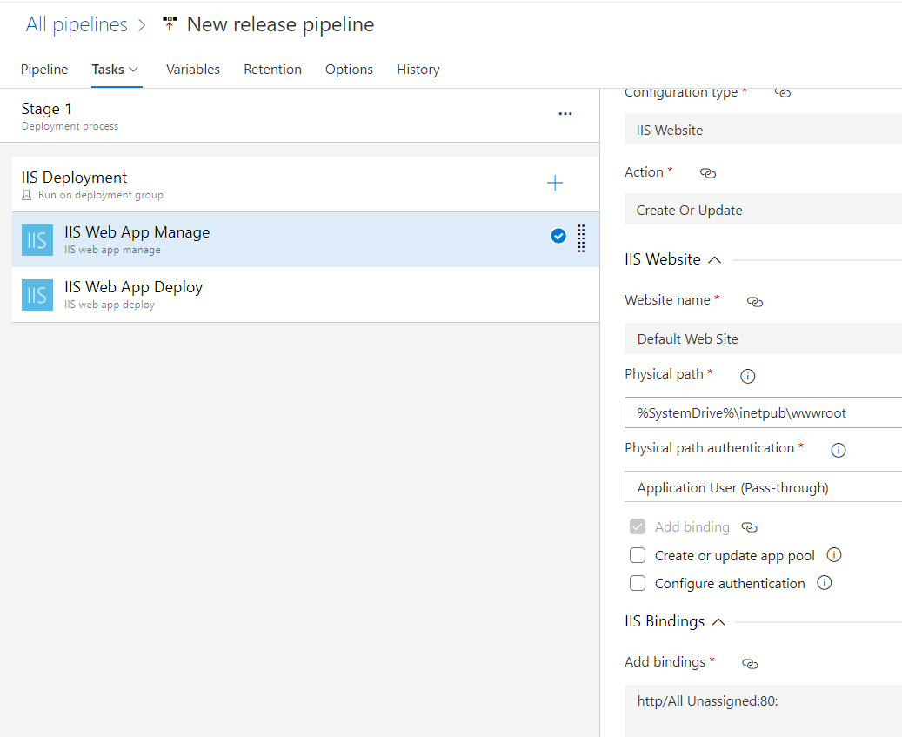
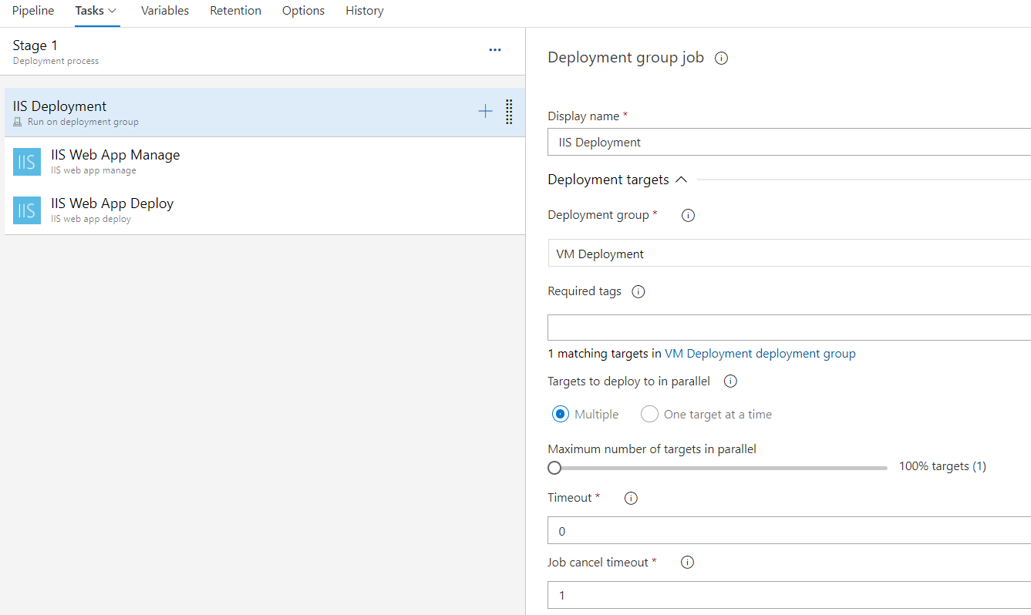
Creating Release Pipeline - Part2

Slide 59
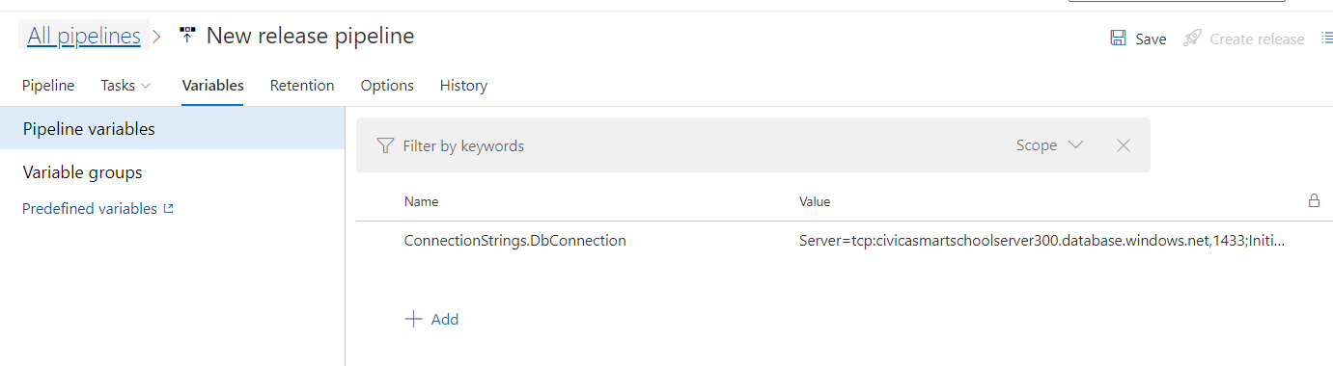
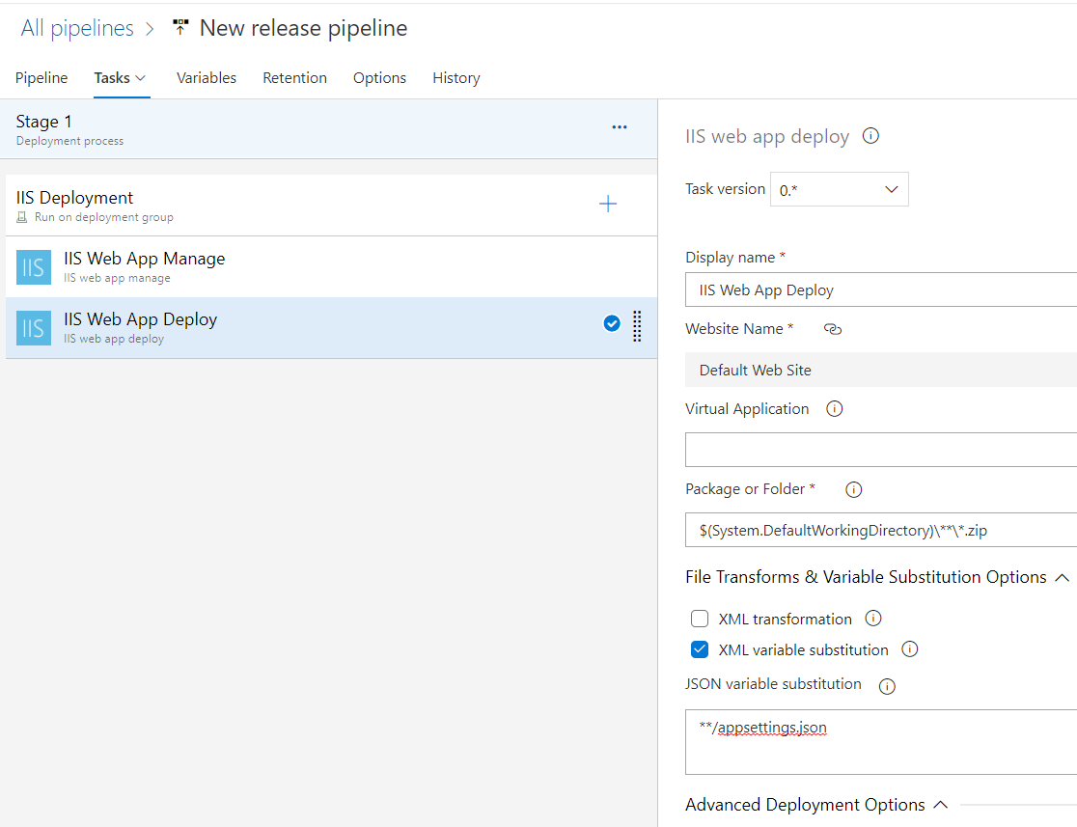
Replacing SQL Connection Strings - Part3

Slide 60
DEMO
Azure AKS CI/CD

Slide 61
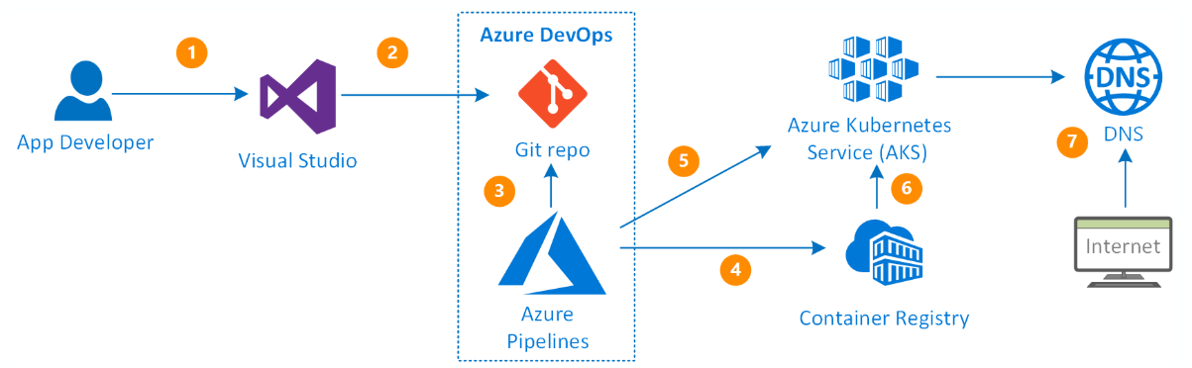
CI/CD Pipeline Using Azure DevOps and AKS
Notes:
https://medium.com/@prakashkumar0301/azure-devops-ci-cd-pipeline-with-aks-409fd2af52a0
https://docs.microsoft.com/en-us/azure/architecture/example-scenario/apps/devops-with-aks
https://www.azuredevopslabs.com/labs/vstsextend/kubernetes/

